Slide 1
Battle Of Neighborhoods - Capstone Project
IINDIAN RESTURANTS IN TORONTO,CANADA

Slide 2
Introduction
Toronto is the most populous city in Canada and the largest urban and metro area, with a population density of 4,149.5 people per square kilometer (10,750/sq mi).Foreign-born people account for nearly half of the population of Toronto. Toronto is home to many ethnic neighborhoods such as Little India, Greektown, Corso Italia, Chinatown and Little Jamaica.
With it's diverse culture , comes diverse food items. The cuisines of Toronto reflects Toronto's size and it's multicultural diversity. Different ethnic neighborhoods throughout the city focus on specific cuisines, such as authentic Chinese and Vietnamese found in the city's six Chinatowns, Korean in Koreatown, Greek on The Danforth, Italian cuisine in Little Italy and Corso Italia, and Indian in Little India. Numerous other world cuisines are available throughout the city, including Portuguese, Hungarian, Japanese, and Caribbean. In addition to ethnic cuisines, Toronto is also home to many fine dining establishments and chain restaurants ranging from fast food to casual or upscale dining.
So as part of this project , we will list and visualize all major parts of Toronto that has great Indian resturants and the prospect of opening a new Indian Restaurant in the neighborhoods of Toronto.

Slide 3
DATA
The demographics info of Canada that contains list Boroughs, Neighborhoods and their postal codes.
Data source : https://en.wikipedia.org/wiki/List_of_postal_codes_of_Canada:_M
Description : This data set contains the required information. And we will use this data set to explore various neighborhoods of Toronto.
Indian resturants in each neighborhood of Toronto.
Data source : Fousquare API
Description : By using this api we will get all the venues in each neighborhood. We can filter these venues to get only indian resturants.
GeoSpace data
Data source : http://cocl.us/Geospatial_data
Description : By using this geo space data we will get the Toronto Borough boundaries along with it's Latitude and Longitude values that will help us visualize choropleth map.

Slide 4


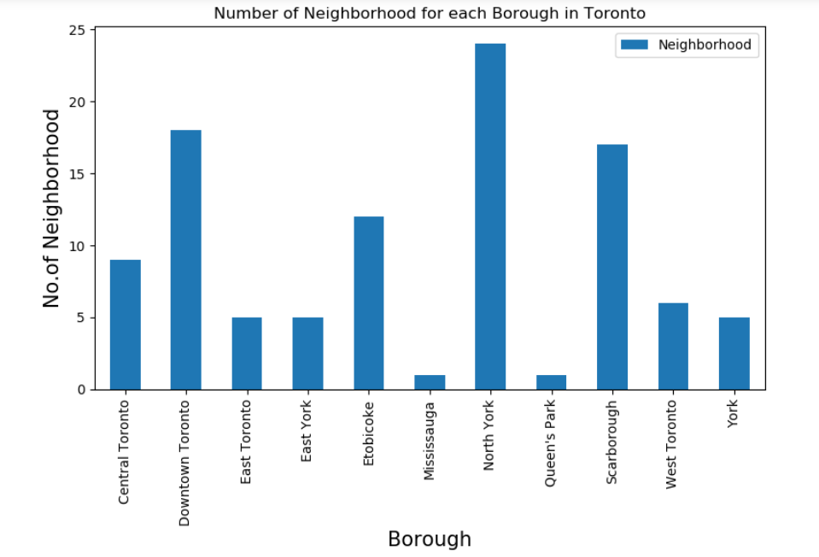

Number of Neighborhood for each Borough in Toronto
z

Slide 5
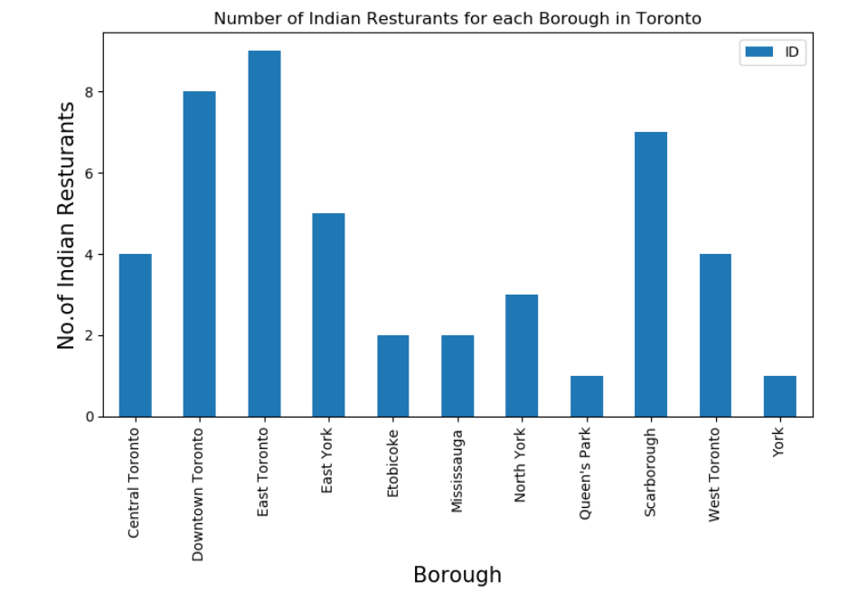
Number of Indian Resturants for each Borough in Toronto
z

Slide 6
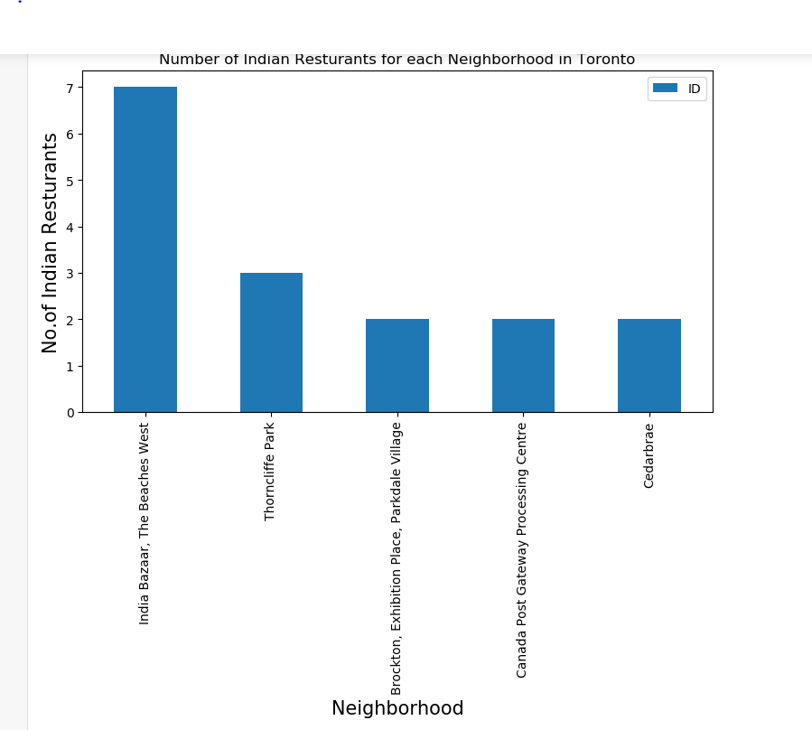
Number of Indian Resturants for each Neighborhood in Toronto
z

Slide 7
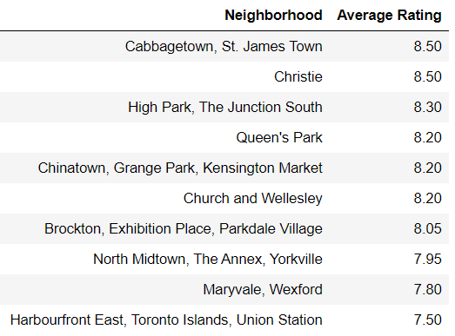
Neighborhoods with top rated Indian Resturants
z

Slide 8
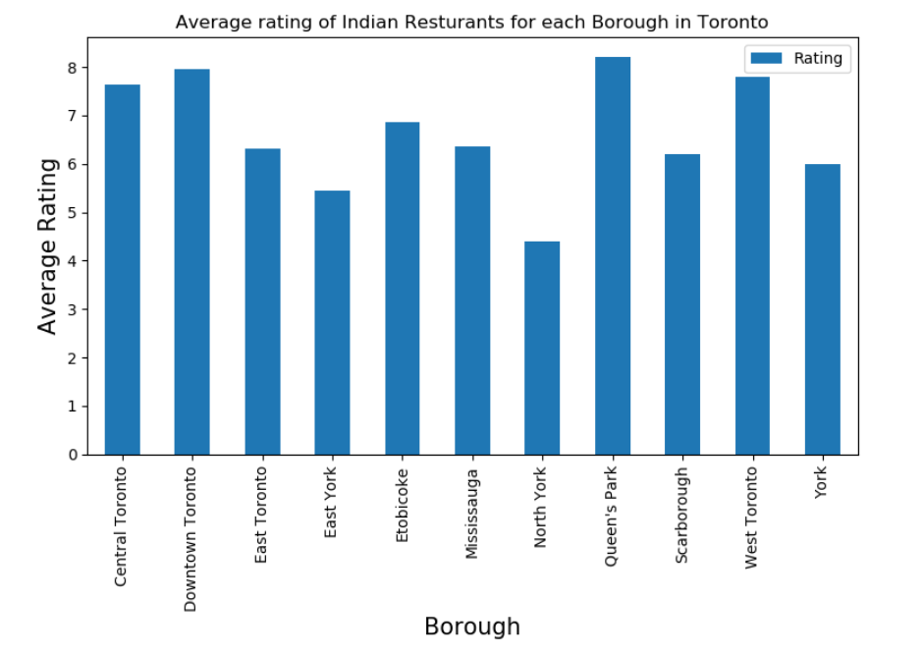
Average rating of Indian Resturants for each Borough in Toronto
z

Slide 9
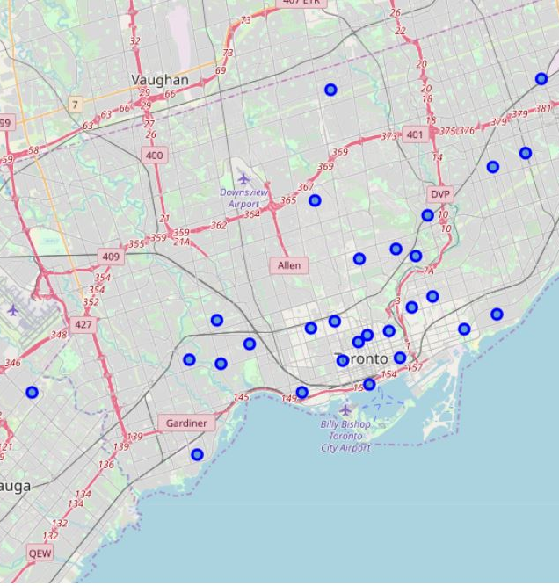
All Indian Restaurants across Toronto
z

Slide 10
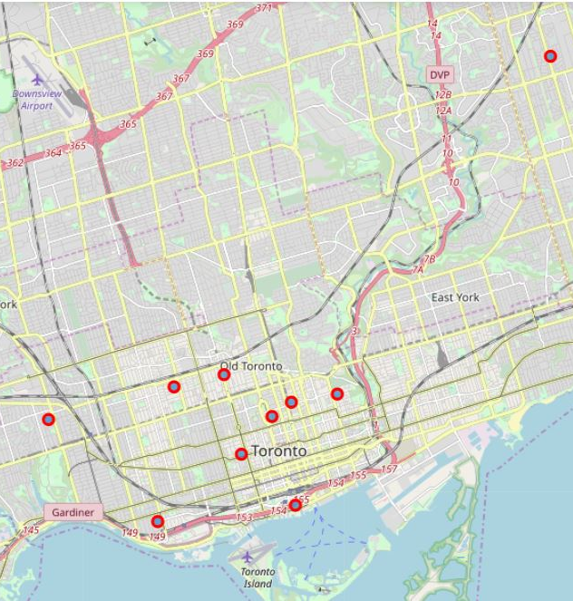
Top Indian restaurants in Toronto
z

Slide 11
Conclusion
The Indian Restaurant Market in Toronto is not quite explored inspire of Toronto sheltering a large number of Indian population. The below are the conclusions from the study:
Central and Old Toronto are some of the best neighborhoods for Indian cuisine.
East Toronto, Scarborough, York have great potential for new Indian Restaurants.
East York last in average rating of Indian Restaurants.
India Baazaar, The Beaches West is the best place to stay if you prefer Indian Cuisine.

Slide 12
Limitations
The ranking is purely on basis of rating of restaurants.
The accuracy of data depends purely depends on the data provided by FourSquare.

